Slide 1
Uniting The Wellness Community and Gilda’s Club Worldwide

Slide 2
Developing Educational Materials for Patients Entering CAR T Cell Therapy and their Caregivers
Presented by: Richa Ruwala, BS
ICEC 2020
October 12-16, 2020
Virtual Conference
Co-authors:
M. Claire Saxton, MBA¹, Susan Ash-Lee, MSW, LCSW¹, Elizabeth Franklin, PhD, LGSW, ACSW¹, Maria Gonzalo, MS¹, Jenny Karubian, MA³, Kirstin Fearnley, MALS¹, Richa Ruwala, BS¹, Alex Swales, MSW¹, Alexandra K. Zaleta, PhD²
¹Cancer Support Community, Washington D.C.
²Cancer Support Community, Research and Training Institute, Philadelphia PA
³Ready to Launch Research, Los Angeles, CA

Slide 3
Conflict of Interest Disclosure
I do not have any potential conflicts of interest to disclose.
This project was made possible with generous support from Kite, a Gilead company.

Slide 4
Objectives
Understand the informational needs of patients and caregivers facing CAR T therapy.
Identify the specific challenges faced by CAR T patients and their caregivers as well as health care provider, patient, and caregiver perceptions of needs.
Identify three educational, logistical, and support needs for CAR patients and caregivers.

Slide 5
Cancer Support Community
Notes:
largest, professionally led nonprofit network of cancer support worldwide
deliver essential services including support groups, educational workshops, exercise, art and nutrition classes, and social activities for the entire family

Slide 6
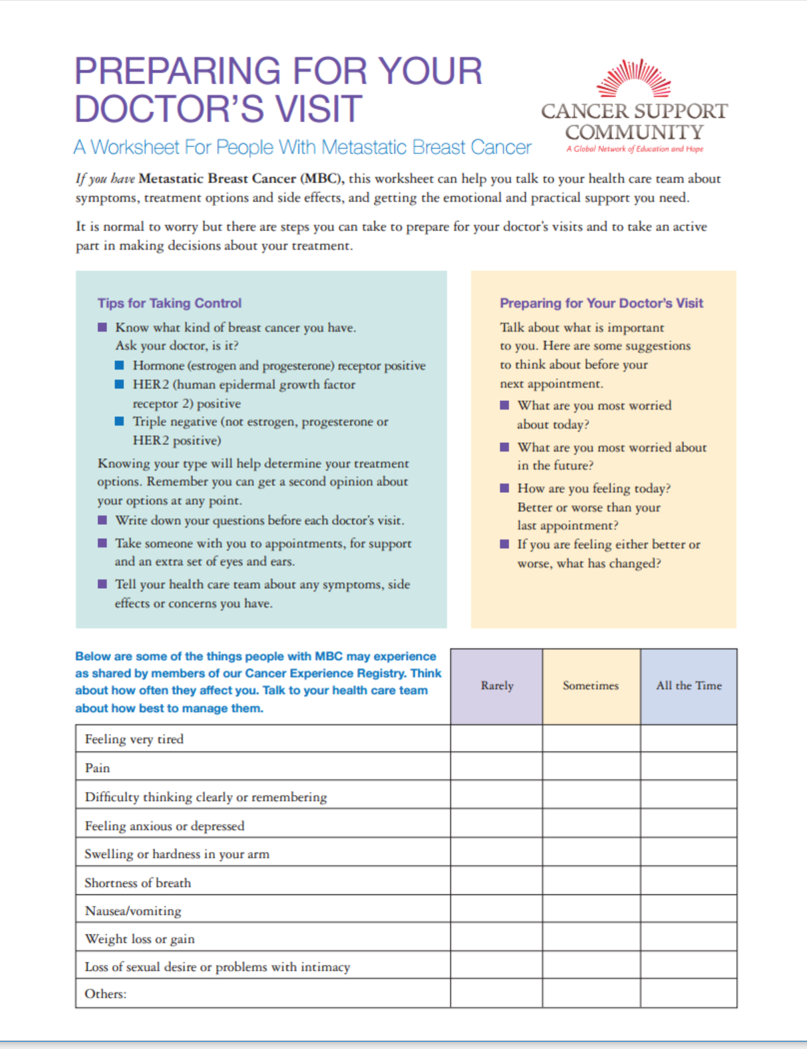
Frankly Speaking About Cancer®
High quality, evidence-based educational programming
Frankly Speaking About Cancer (FSAC)
Provide easy to understand in-depth coverage of topics relevant to those affected by cancer
To educate and to empower cancer patients, survivors, caregivers, and health care professionals
Topics are tumor type-specific (e.g. melanoma, lung, metastatic breast, liver, colorectal, multiple myeloma) or cross-tumors (e.g. immunotherapy, clinical trials, treatments and side effects)
Provide up-to-date content and reflect new advances in knowledge
Notes:
landmark cancer education series, providing evidence-based medical and psychosocial information for patients with cancer and their loved ones
variety of delivery mechanisms (including print publications, online and interactive education, in-person programs, and radio shows)
To date, CSC has reached hundreds of thousands of people whose lives have been touched by cancer

Slide 7
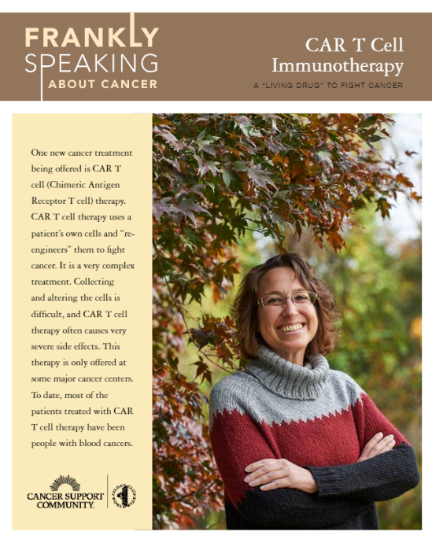
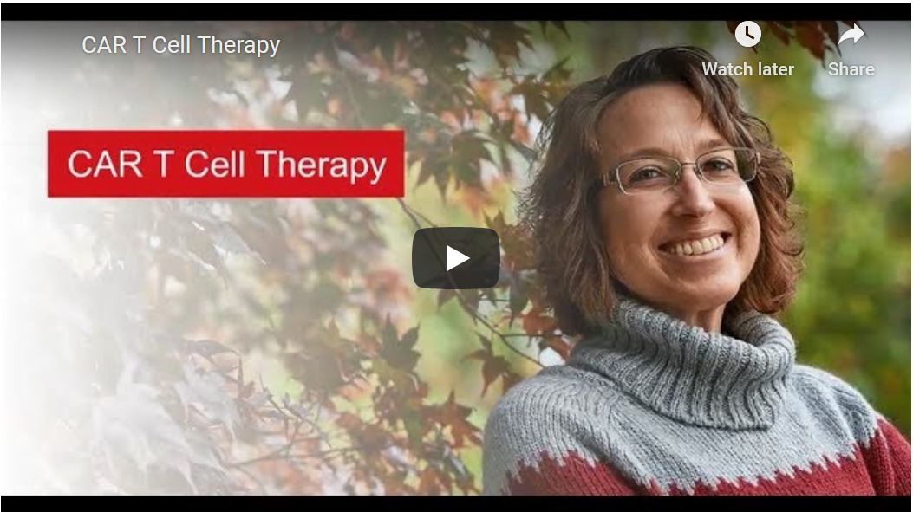
FSAC CAR T Program
Notes:
CAR T cell therapy is an novel therapy in which the patient’s T cells are removed, programmed with a CAR antigen, and reinfused into the patient’s blood steam. It is a treatment that has shown to be effective in clinical trials for multiple cancer types, such as ALL, large B-cell lymphomas, and mantle cell lymphomas. Also being tested in other blood cancers and tumor types.

Slide 8
CAR T
Challenges:
New treatment, few centers offer CAR T
“Last chance” option; patients have relapsed or not responded to previous treatments
Complicated treatment process with many steps
Severe side effects
Treatment is not a repeating cycle
Important for patients & caregivers to understand the steps, risks, and potential out-of-pocket costs
Notes:
Challenges of CAR T:
New treatment, few centers that offer CAR T. must travel a considerable distance for this treatment
a complex therapy, with many steps leading up to the actual infusion of CAR T cells
Distress and anxiety are often high for patients on CAR T cell therapy, as this may be considered a “last chance” option to treat their cancer.
patients have relapsed or not responded to previous cancer treatments and are often quite ill. a lot of financial toxicity, fatigue, short- & long-term effects, & can be fairly medically fragile. The caregivers also come having already experienced a great deal of caregiver fatigue from previous treatments (often including multiple stem cell transplants, which also require the same kind of 24/7 caregiver support for multiple weeks)
CAR T cell therapy side effects can be severe: neurotoxicity and cytokine release syndrome (CRS). CRS can cause a myriad of problems, ranging from fever and fatigue to life-threatening breathing issues and low blood pressure. CAR T cell therapy side effects may be acute and, so far, are understood to be short-term.
Unlike most other cancer drug therapies (and similar to stem cell transplant), this is not a therapy given in a repeating cycle. So what patients "learn" about how to cope at the previous step, doesn't necessarily help them cope at the next step of this multi-step process
It is important for patients and their loved ones to fully understand the steps of the CAR T cell therapy process, risks associated with the therapy, and potential out-of-pocket treatment costs, as well as travel expenses and potential workdays lost for themselves and caregivers. This allows patients and caregivers to be active members of their health care team and to enter treatment and survivorship with realistic expectations.

Slide 9
FSAC CAR T Program
Notes:
To date, CSC’s FSAC program offers a comprehensive set of educational materials that help explain CAR T cell therapy to patients and caregivers.
Frankly Speaking About Cancer®: CAR T Cell Immunotherapy booklet
8-page booklet gives an overview of the science and experience behind CAR T cell therapy. helps explain CAR T cell therapy to an audience of patients and caregivers who may be wholly unfamiliar with the treatment.
Frankly Speaking About Cancer®: A Quick Guide to CAR T Cell Therapy eLearning
eLearning quick guides use animation, illustrations, voice-overs, videos, and photographs of actual patients and caregivers to discuss the information from the CAR T Cell Immunotherapy booklet. The 20-minute quick guide is available on YouTube and CSC’s website.

Slide 10
CAR T Needs Assessment
Developing an in-depth education guide for patients (and their caregivers) being screened for and undergoing CAR T cell therapy
CSC conducted a series of qualitative needs assessments with patients, caregivers, and health care providers at cancer centers administering the therapy
Goal: To inform the development of educational materials for patients and caregivers undergoing CAR T therapy, CSC investigated health care provider, patient, and caregiver perceptions of needs
Notes:
to better understand how to prepare for and what to expect during treatment
To better understand the challenges faced by patients and their loved ones during CAR T cell therapy, CSC conducted a series of qualitative assessments with health care providers as well as patients and caregivers at 5 cancer centers administering the therapy. These assessments consisted of interviews in which respondents will be asked about what resources would be most useful to patients undergoing CAR T cell therapy.
CSC explored the challenges faced by CAR T patients and their caregivers, attempting to capture educational, logistical, and support needs for these patients and caregivers.

Slide 11
Methods
2 in-person and virtual focus groups (90 minutes each)
1 via Zoom
1 in-person
9 telephone interviews with patients, caregivers, and health care providers (1 hour each)
Touchpoints document
Questions were designed to identify:
Educational needs
Support needs
Logistical needs
Resources that would be most useful to those facing CAR T therapy
Communication gaps
Generic timetable for CAR T Therapy provision
Notes:
Based on the interviews and discussions with the advisory board, CSC has an analysis and a detailed “Touchpoints” document that specifies each potential stop on the CAR T cell therapy process as well as patient and caregivers’ needs for education and support. Touchpoints Document was reviewed by our Advisory Board Members at two separate teleconference meetings. Our Advisory Board includes many of the people interviewed as well as an additional Medical Oncologist from Fred Hutch’s CAR T program.
The Needs Assessment analysis and Touchpoints document was completed in July 2019 and has been a critical guiding point in the development of the FSAC: CAR T Patient/Caregiver Guide (Spotlight Book).

Slide 12
Characteristics of the Sample
4 patients who received CAR T cell therapy
3 caregivers
4 medical oncologists
3 nurses
1 director of nursing
1 social worker
1 patient coordinator/navigator
Notes:
After receiving IRB approval, CSC conducted needs assessment interviews with members of multi-disciplinary CAR T teams from University of Pennsylvania, University of Rochester, Massachusetts General Hospital Cancer Center, Rutgers Cancer Institute of New Jersey, and Fox Chase Cancer Center at Temple University Hospital.
In addition, we have also interviewed 3 CAR T cell therapy survivors and 3 caregivers. Based on the interviews and discussions with the advisory board, CSC has an analysis and a detailed “Touchpoints” document that specifies each potential stop on the CAR T cell therapy process as well as patient and caregivers’ needs for education and support.

Slide 13
General Unmet Educational Needs
Resources desired by patients and caregivers:
Educational materials and videos explaining treatment at each step
Documents/videos describing side effects and giving clear instructions for caregivers
Documents/videos explaining treatment timeline from apheresis through post-infusion
Videos or online resources that share success stories
Notes:
Because CAR-T treatment is highly specialized, medical teams (including social workers) tend to be highly engaged and anticipate patient needs before they occur.
As CAR-T becomes more widely available, more educational resources can remove the burden from treatment teams who currently have to explain the treatment and logistic concerns many times over. There is a lack of resources that are desired by patients and caregivers.
Our findings indicate that there is a lack of resources that are desired by patients and caregivers. These include:
Educational materials and videos that explain the treatment at each step
Documents/videos that describe side effects and give clear instructions for caregivers
Documents/videos that explain the timeline of treatment from apheresis through post-infusion
Videos or online resources that share success stories, this can alleviate some of the anxiety around the efficacy of treatment
including patients surviving even when having severe CRS or severe nuerotoxicities AND patients where CAR T worked even though they DIDN'T have side effects because patients & caregivers have anxiety about both extremes

Slide 14
Patients’ Unmet Educational Needs
CAR-T Patients would like to have materials that clearly explain the CAR-T treatment process. These materials will ideally:
Explain the regimen from beginning to end
Show the different phases of treatment with a clear timeline and milestones
Describe the most common side effects
“I think [it’s important to have] something to read that was easy to understand...exactly what is CAR T-cell immunotherapy treatment, what does it entail …the lymphodepleting chemotherapy, the after effects.” - Patient
“I think [it’s important to have] …pamphlets where they can understand in layman's terms, what is CAR T-cell treatment? What are the common side effects? What are patients' experiences?” - Patient

Slide 15
Caregivers’ Unmet Educational Needs
Caregivers did not feel there were adequate resources for them considering the time commitment required
Caregivers were shocked by severity of acute symptoms
Resources desired include:
Information on side effects, what to watch out for, and fair warning about the severity of acute symptoms
Increased emotional support
Online support groups
Local information for the area to plan their stay
External resources to help cover travel expenses
“Try to be really organized. Make lists of things you need to do. Kind of like when you go on a vacation, you have your list of things you need to do and buy.” - Caregiver
“I know the doctors and nurses, and hospital staff did their best, but I really think...caregivers of the patient need a lot more emotional support.” - Caregiver
Notes:
Caregivers feel that there is a dearth of resources available for them, despite the time commitment that is required for their loved ones to go through CAR-T treatment.
Caregivers who experienced loved ones going through CAR T were shocked by the severity of these acute symptoms, they need better resources so they can be prepared.

Slide 16
Who’s Who
CAR-T patients and caregivers would like an information sheet that has information for all relevant staff during and after treatment. The sheet should include:
Each staff member, with name and contact info
Instructions on who to call (doctor, nurse, patient coordinator) for each individual issue such as side effects, logistic concerns, or emotional support needs
“You're always going to meet your care team, so make sure that you understand who these people are and how to communicate with them. When you meet somebody, make an effort to really know who they are, know what they do and how they can help you and how you can communicate with them.” - Caregiver
“All patients meet with a social worker. We need to make sure that they have...access to care providers, make sure that they are emotionally understanding what's going on, and that they're going to have the support that they need for post-discharge.” - Doctor

Slide 17
Health Care Providers’ Needs
Materials that explain how CAR-T works to share with patients and caregivers by:
Explaining how CAR-T treatment works at a biological level
Breaking down each phase of treatment, including how each phase works at the cellular level and why each step is necessary
Being written for a layperson so that patients can share them with loved ones who want to understand the treatment
“Most people are going to be so overwhelmed …I think that they're going to have to circle back around a number of times to come to an understanding of how [the treatment is] going to work. And so that's why [it’s important to have] it on the website where they can click through as many times they want to look at it.” - Doctor
“[Patients have] told me that explaining to family and friends [is] exhausting to them, and if they just had something that they could be, 'look at this link, this is what...my treatment is,’ things they can hand out.” - Nurse

Slide 18
Key Findings
This diagram represents points in the CAR-T process in which patients and caregivers want more information, resources, or support.
Learning about CAR-T
Initial Qualification
Side Effects
Timeline
Who’s Who?
Emotional Support
Away from home
Post Infusion
Outside
Resources
Caregivers want emotional support resources
Unprepared for severe acute CRS symptoms
How to qualify and what scans/tests are needed
Timeline for treatment
How the treatment works; want to hear success stories
Info on what side effects to expect; caregivers felt unprepared following infusion
A contact list with names of relevant providers and each person’s role on the team
Info about the local area where they will be staying to better plan their stays
An exhaustive list of outside resources to help offset costs

Slide 19
Needs Assessment Conclusions
Much like information needed at the beginning of the development of bone marrow & stem cell transplant, there is a lot of need for services
For both patients and providers, treatment-related side effects are top of mind
Need extra support around logistics & travel, since so many patients & caregivers will live at a distance from their CAR T center
This underscores the importance of developing turnkey education, resources, and tools to help patients and caregivers understand and manage CAR T-related side effects
Notes:
CSC’s needs assessment indicate that for both patients and providers, treatment-related side effects are top of mind. This underscores the importance of developing turnkey education, resources, and tools to help patients and caregivers understand and manage CAR T-related side effects.
Needs assessments results are currently informing the development of a comprehensive CAR T patient educational program. Once the materials are developed, CSC will reach out to all current CAR T institutions to give them the opportunity to promote and distribute these vital resources to their CAR T patients and caregivers.

Slide 20
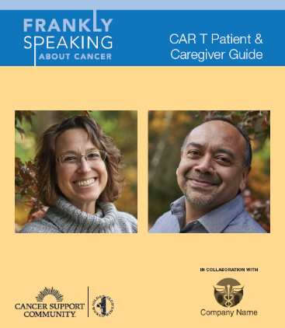
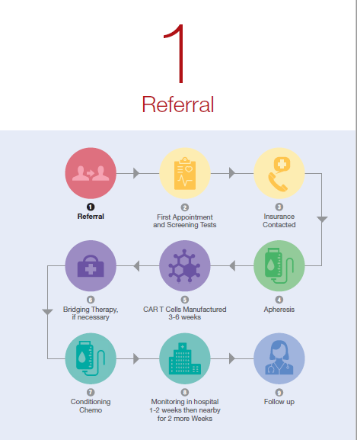
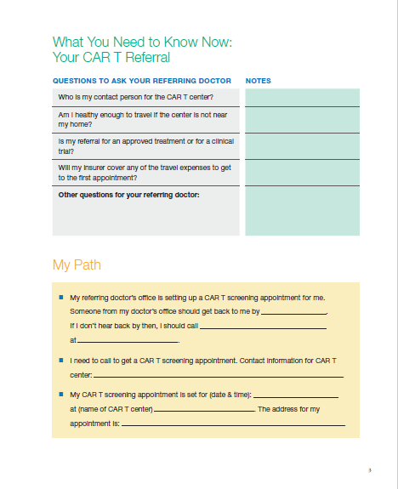
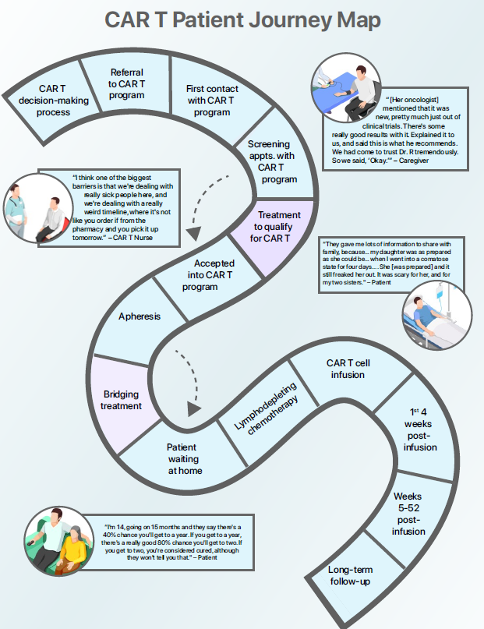
Next Steps
Patient/caregiver guide with integrated Patient/Provider discussion tools and treatment planning worksheets
Guide will be printed, posted online, and offered to CAR T institutions
Journey Map
Touchpoints Document
Additional eLearning videos
Materials integrate support from MyLifeLine CAR T discussion group & specialized 800# for Cancer Support Helpline
Notes:
As a result of the needs assessment, CSC has drafted a patient/caregiver guide that includes integrated Patient/Provider discussion tools and planning worksheets. Once reviewed by our advisory board, it will be printed, posted online, and offered to CAR T institutions for their patients. We will offer it at no charge for patients & caregivers and to CAR T centers with some charges if they want to “white label” them so that they look like their institution produced them.
Once the materials are developed, CSC will reach out to all current CAR T institutions to give them the opportunity to promote and distribute these vital resources to their CAR T patients and caregivers.

Slide 21
References
McConville, H., Harvey, M., Callahan, C., Motley, L., Difilippo, H., & White, C. (2017). CAR T-cell therapy effects: Review of procedures and patient education [Online exclusive]. Clinical Journal of Oncology Nursing, 21(3), E79–E86. https://doi.org/10.1188/17.CJON.E79-E86
Aspiras A, Power NJ, Gonzalo MB (2018) Survey analysis: Assessing the needs of immunotherapy patients, caregivers, and health care providers. Journal of Clinical Oncology 36 (5_suppl):135-135
Saxton C, Amsellem M, Hollen H, Zaleta AK (2017) Educating cancer patients about immunotherapy: Gains from attending a national educational immunotherapy workshop. Society for Immunotherapy of Cancer. National Harbor, MD

Slide 22
THANK YOU!
For More Information, contact Richa Ruwala at rruwala@cancersupportcommunity.org
To order Frankly Speaking About Cancer materials visit: Orders.CancerSupportCommunity.org 888-793-9355

